Slide 1
TSF3313 FILE SYSTEM FORENSICS
Chapter 3
Hard Disk Data Acquisition

Slide 2
Hard Disk Data Acquisition
The analysis of data found on a storage device, namely a hard disk.
Data can be analyzed on a live system, but it is more common to acquire a copy of the data for a dead analysis.
Acquisition typically occurs during the System Preservation phase of an investigation and is one of the most important phases in a digital forensic investigation because if data are not collected from the system, they could be lost and therefore not recognized as evidence.
Further, if data are not collected properly, their value as legal evidence is diminished.
Notes:
What it means:
Data acquisition = creating an exact copy of a suspect’s hard disk.
The copy allows analysis in a controlled lab without altering the original evidence.
photocopying every page of a book to study it later without touching the original.
every byte copied preserves evidence integrity.

Slide 3

Introduction
A technique that is commonly used in the preservation of a system is to make duplicate copies of the hard disks so that they can be brought to a lab for a dead analysis.

Slide 4
Introduction
The general, and intuitive, procedure for acquiring a storage device is to copy one byte from the original storage device (the source) to a destination storage device and repeat the process.
Computers copy data from the suspect systems in chunks of data, ranging from 512 bytes to many thousands of bytes.
The chunks of data that are transferred each time are typically a multiple of 512 bytes, because that is the size of most disk sectors.
If the acquisition tool encounters an error while reading data from the suspect drive, many of the tools will write zeros to the destination.
General Acquisition Procedure
Notes:
The tool copies chunks of data (usually multiples of 512 bytes).
If a read error occurs, the tool often writes zeros to the destination to keep structure consistent.
copying happens in “blocks” instead of one byte at a time.
zeros are used — to preserve data position even if content is unreadable.

Slide 5
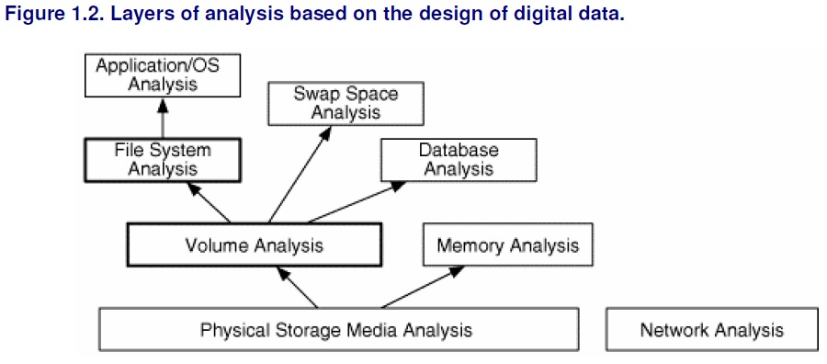
Introduction
The general theory of non-volatile data acquisition is to save every byte that we think may contain evidence.
Data can be interpreted at different layers; for example, the disk, volume, file, and application layers.
At each layer of abstraction, data are lost. Therefore, the rule of thumb is to acquire data at the lowest layer that we think there will be evidence.
For most cases, an investigator will acquire every sector of a disk, which is what we cover in this chapter.
Note that when we save only the contents of each sector, we lose data that data recovery specialists may need.
Data Acquisition Layers
Notes:
There are multiple levels where data can be captured:
Disk level (lowest) – captures everything, even deleted files.
Volume level – captures each partition’s sectors.
File level – captures only visible, allocated files.
Disk → Volume → File → Application
The lower you go, the more evidence you can preserve.
Example discussion:
File-level capture misses deleted/hidden data.
Disk-level capture allows recovery of deleted files or hidden data.

Slide 6
Introduction
Suppose that we acquired a disk at the volume level and we made a copy of every sector in each partition.
This would allow us to recover deleted files in each partition, but we would not be able to analyze the sectors that are not allocated to partitions.
Suppose that we used a backup utility and copied only allocated files.
In this case, we would not be able to recover deleted files, we might not have access to all the temporal data, and we would not be able to find data that has been hidden inside partition or file system data structures.
Sometimes a backup is the only available data, and the investigator needs to make the most of it.
A scenario where a backup would be critical is in a corporate environment where a server is not responding because its disks were wiped with 0s and then rebooted.
The last backups of the system might provide clues about who had access to the system and whether an attacker had compromised it.
Data Acquisition Layers (cont.)

Slide 7
Introduction
For some systems, our rule of thumb about acquiring at the level where we think there will be evidence means that we need to copy only files.
Consider an intrusion investigation where there is an Intrusion Detection System (IDS) that contains log entries corresponding to the attack.
If we do not think that the IDS was compromised, the only evidence on the system is at the file level, and we can simply copy the necessary logs and take the appropriate preservation steps.
If we think that the IDS was compromised, we should acquire it at the disk level so that we can analyze all the data.
Data Acquisition Layers (cont.)

Slide 8
Introduction
Acquisition is a crucial part of the investigation process, and the National Institute of Standards and Technology (NIST) has conducted tests on common acquisition tools.
The Computer Forensic Tool Testing (CFTT) project at NIST developed requirements and test cases for disk-imaging tools.
The results and specifications can be found on their Web site (http://www.cftt.nist.gov/disk_imaging.htm).
How about Malaysia?
Acquisition Tool Testing
Notes:
Concept:
NIST (National Institute of Standards and Technology) tests forensic tools for reliability.
Their CFTT project defines requirements for disk-imaging tools.

Slide 9
ISO/IEC 17025 + forensic extensions
forensic labs are held to recognized quality standards through the national accreditation scheme (SAMM)
Legal and procedural framework demanding that labs are competent
Malaysia doesn’t have a widely advertised, dedicated forensic-tool testing authority.
  What advantages would Malaysia gain if it had a national forensic tool‐testing body?
  What risks arise if a forensic lab uses a tool without external validation?
  How should an analyst in Malaysia validate a new open-source forensic tool to ensure it is court-admissible here?
Notes:
Works competently,
Produces valid, repeatable results, and
Maintains traceable evidence and quality control.

Slide 10
Examples of What a Forensic Lab Must Have
Aspect | Requirement / Practice | Example
Tool Validation | Tools must be tested for accuracy before case use. | Verify FTK/EnCase produces identical image (hash match).
Method Validation | Procedures must be proven reliable. | Document imaging steps using write blockers and checksum.
Chain of Custody | Evidence must be traceable at all times. | Signed log for every evidence handover.
Analyst Competency | Staff must be trained and tested. | Annual proficiency tests and tool training.
Quality Management | Maintain SOPs and quality reviews. | Quality Manual describing all lab procedures.
Secure Environment | Protect evidence and system integrity. | Isolated lab, restricted access, no internet.

Slide 11
Reading the Source Data
There are two major parts of the acquisition process.
First, we need to read data from a source, and
Second, we need to write it to the destination.
This chapter focuses on the analysis of volume and file system data, we are going to cover the process of acquiring at the disk level (because that is where the volume data structures are located).

Slide 12
Reading the Source Data
There are two methods in which the data on a disk can be accessed.
  the operating system or acquisition software accesses the hard disk directly - requires the software to know the hardware details
  the operating system or acquisition software accesses the hard disk through the Basic Input/Output System (BIOS) - should know all the hardware details
Direct versus BIOS Access
Notes:
Reading the Source Data
There are two main methods:
Direct Access – the tool communicates directly with the disk.
BIOS Access – the tool requests data through the system’s BIOS.
Compare BIOS access to “asking someone else to fetch a book for you” vs. “getting it yourself.”
Direct access is more reliable, as BIOS can report wrong disk sizes (e.g., 12GB disk shown as 8GB).

Slide 13
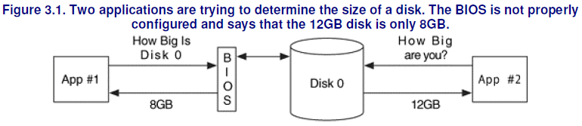
Reading the Source Data
When the BIOS is used, there is a risk that it may return incorrect information about the disk.
If the BIOS thinks that a disk is 8GB, but the disk is really 12GB, the INT13h functions will give you access to only the first 8GB.
Therefore, if you are doing an acquisition of the disk, you will not copy the final 4GB.
We can see this in Figure 3.1, where two applications are trying to identify the size of a disk using different methods.
Direct versus BIOS Access (cont.)

Slide 14
Reading the Source Data
This scenario can happen in a couple of different ways.
One case is when the BIOS is configured for a specific hard disk geometry that is different from the one installed.
In another case, an acquisition tool uses a legacy method of requesting the size of the disk.
There are two ways that an application can ask the BIOS for a disk size.
One is through the original INT13h function that suffers from the 8GB limit and returns the size using the disk’s geometry in CHS format.
The second method is to use an extended INT13h function that returns the size in LBA format. The CFTT group at NIST had a 2GB disk and a computer where two different sizes were returned from the INT13h and the extended INT13h functions.
The extended INT13h result was correct, but the legacy INT13h result was too small.
Direct versus BIOS Access (cont.)

Slide 15
Reading the Source Data
Occasionally, an e-mail is sent to one to the digital forensic e-mail lists from someone who acquired a disk using two different tools and got different sized images.
The reason is usually because one of the tools used the BIOS and the other did not.
Make sure that you know how your acquisition tools access the disk, and if the tool uses the BIOS, make sure it reports the full disk before you acquire the disk.
The BIOS adds one more location where an error can be introduced into the final image, and it should be avoided if better alternatives exist.
Direct versus BIOS Access (cont.)

Slide 16
Reading the Source Data
An investigator has the choice of performing a dead or a live acquisition of data.
A dead acquisition occurs when the data from a suspect system is being copied without the assistance of the suspect operating system.
Historically, the term dead refers to the state of only the operating system, so a dead acquisition can use the hardware from the suspect system as long as it is booted from a trusted CD or floppy.
A live acquisition is one where the suspect operating system is still running and being used to copy data.
Dead Versus Live Acquisition

Slide 17
Reading the Source Data
The risk of conducting a live acquisition is that the attacker has modified the operating system or other software to provide false data during the acquisition.
Attackers frequently install tools called rootkits into systems that they compromise, and they return false information to a user.
The rootkits hide certain files in a directory or hide running processes.
Typically, the attackers hide the files that they installed after compromising the system.
An attacker could also modify the operating system so that it replaces data in certain sectors of the disk while it is being acquired.
The resulting image might not have any evidence of the incident because it was replaced.
When possible, live acquisition should be avoided so that all evidence can be reliably collected.
Dead Versus Live Acquisition (cont.)

Slide 18
Reading the Source Data
It is common for an investigator to boot a suspect system using a trusted DOS floppy or Linux CD that has been configured to not mount drives or modify any data.
Technically, it is possible for the suspect to have modified their hardware so that it returns false data even with a trusted operating system, but that is much less likely than the operating system being tampered with.
Dead Versus Live Acquisition (cont.)

Slide 19
Dead vs. Live Acquisition
Type | Description | Risks
Dead Acquisition | Done when system is off or booted from trusted media. | More reliable; minimizes tampering.
Live Acquisition | Done while suspect’s OS is running. | Risk of false data (rootkits, altered OS).
Notes:
Dead acquisition is like taking a photo of a crime scene after securing it. Live acquisition is like trying to take a photo while people are still moving things around.

Slide 20
Reading the Source Data
When an acquisition tool is reading data from a disk, it needs to be capable of handling errors.
The errors could be caused by a physical problem where the entire drive no longer works, or the errors could be in a limited number of sectors.
If only a limited number of sectors is damaged, a normal acquisition can occur, provided that the acquisition tool properly handles the errors.
Error Handling
Notes:
Concept:
Bad sectors may exist due to hardware issues.
Proper handling = log bad sectors + fill unreadable areas with 0s.
a 5-block copy where block 3 fails, so tool writes zeros in that position.
Explain that skipping sectors would change offsets and corrupt the structure.

Slide 21
Reading the Source Data
The generally accepted behavior for dealing with a bad sector is to log its address and write 0s for the data that could not be read.
Writing 0s keeps the other data in its correct location.
If the sector were ignored instead of writing 0s, the resulting copy would be too small, and most analysis tools would not work.
Figure 3.2 shows a series of values that are being acquired.
Three of the values have errors and cannot be read, so 0s are written to the copy.
Error Handling (cont.)

Slide 22
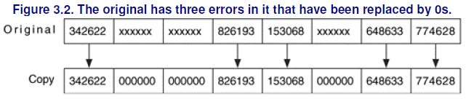
Reading the Source Data
Error Handling (cont.)

Slide 23
Reading the Source Data
When acquiring data from an ATA disk, you should pay attention to the Host Protected Area (HPA) of the disk because it could contain hidden data.
Unless an acquisition tool looks for an HPA, it will not be acquired.
A tool can detect an HPA by comparing the output of two ATA commands.
The READ_NATIVE_MAX_ADDRESS command gives the total number of sectors on the disk, and the IDENTIFY_DEVICE returns the total number of sectors that a user can access.
If an HPA exists, these two values will be different.
Host Protected Area (HPA)
Notes:
“Imagine your hard disk is like a book with 100 pages. Normally, your computer can see and use all 100 pages. But the manufacturer (or sometimes a hacker) can secretly hide a few pages at the back — say pages 95 to 100 — so you can’t read or even know they exist. That hidden section is called the Host Protected Area (HPA).

Slide 24

Thank you
تريما کاسيه
شكرا
谢谢
நன்றி

